Slide 1
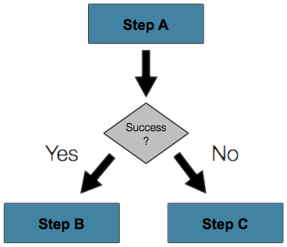

Operators, Expressions and Conditionals
Perform Calculations and Control Flow
Telerik Software Academy
Learning & Development Team
http://academy.telerik.com

Slide 2

Table of Contents
Operators and Operator Precedence
Arithmetic Operators
Logical Operators
Bitwise Operators
Comparison Operators
Assignment Operators
Implicit and Explicit Type Conversions
Expressions
If-else Statements
Switch-case Statements

Slide 3

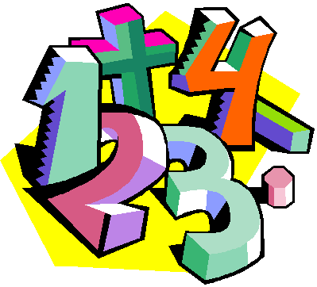
Operators in C++
Arithmetic, Logical, Comparison, Assignment, Etc.

Slide 4
What is an Operator?
Operator is an operation performed over data at runtime
Takes one or more arguments (operands)
Produces a new value
Operators have precedence
Precedence defines which will be evaluated first
Expressions are sequences of operators and operands that are evaluated to a single value

Slide 5

Operators in C++
Operators in C++ :
Unary – take one operand
Binary – take two operands
Ternary (?:) – takes three operands
Except for the assignment operators, all binary operators are left-associative
The assignment operators and the conditional operator (?:) are right-associative

Slide 6
Categories of Operators in C++
Category | Operators
Arithmetic | + - * / % ++ --
Logical | && || ^ !
Binary | & | ^ ~ << >>
Comparison | == != < > <= >=
Assignment | = += -= *= /= %= &= |= ^= <<= >>=
String concatenation | +
Other | . [] () ?: new

Slide 7
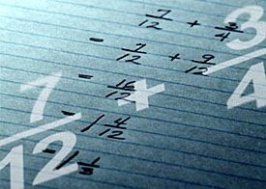
Arithmetic Operators

Slide 8
Arithmetic Operators
Arithmetic operators +, -, * are the same as in math
Division operator / if used on integers returns integer (without rounding) or exception
Division operator / if used on real numbers returns real number or inf or nan
Remainder operator % returns the remainder from division of integers
The special addition operator ++ increments a variable

Slide 9
Arithmetic Operators – Example
int squarePerimeter = 17;
double squareSide = squarePerimeter / 4.0;
double squareArea = squareSide * squareSide;
cout<<squareSide<<endl; // 4.25
cout<<squareArea<<endl; // 18.0625
int a = 5;
int b = 4;
cout<<a + b<<endl;// 9
cout<<a + b++<<endl; // 9
cout<<a + b<<endl; // 10
cout<<a + (++b)<<endl; // 11
cout<<a + b<<endl; // 11
cout<<12 / 3<<endl; // 4
cout<<11 / 3<<endl; // 3

Slide 10
Arithmetic Operators – Example (2)
cout<<11.0 / 3<<endl; // 3.666666667
cout<<11 / 3.0<<endl;; // 3.666666667
cout<<11 % 3<<endl;; // 2
cout<<11 % -3<<endl;; // 2
cout<<-11 % 3<<endl;; // -2
cout<<1.5 / 0.0<<endl;; // inf
cout<<-1.5 / 0.0<<endl;; // -inf
cout<<0.0 / 0.0<<endl;; // nan
int x = 0;
cout<<5 / x<<endl;; // throws exception

Slide 11

Arithmetic Operators
Live Demo

Slide 12

Logical Operators

Slide 13
Logical Operators
Logical operators take boolean operands and return boolean result
Operator ! turns true to false and false to true
Behavior of the operators &&, || and ^ (1 == true, 0 == false) :
Operation | || | || | || | || | && | && | && | && | ^ | ^ | ^ | ^
Operand1 | 0 | 0 | 1 | 1 | 0 | 0 | 1 | 1 | 0 | 0 | 1 | 1
Operand2 | 0 | 1 | 0 | 1 | 0 | 1 | 0 | 1 | 0 | 1 | 0 | 1
Result | 0 | 1 | 1 | 1 | 0 | 0 | 0 | 1 | 0 | 1 | 1 | 0

Slide 14
Logical Operators – Example
Using the logical operators:
bool a = true;
bool b = false;
cout<<(a && b)<<endl; // False
cout<<(a || b)<<endl; // True
cout<<(a ^ b)<<endl; // True
cout<<(!b)<<endl; // True
cout<<(b || true)<<endl; // True
cout<<(b && true)<<endl; // False
cout<<(a || true)<<endl; // True
cout<<(a && true)<<endl; // True
cout<<(!a)<<endl; // False
cout<<((5>7) ^ (a==b))<<endl; // False

Slide 15

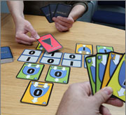
Logical Operators
Live Demo

Slide 16

Bitwise Operators

Slide 17
Bitwise Operators
Bitwise operator ~ turns all 0 to 1 and all 1 to 0
Like ! for boolean expressions but bit by bit
The operators |, & and ^ behave like ||, && and ^ for boolean expressions but bit by bit
The << and >> move the bits (left or right)
Behavior of the operators|, & and ^:
Operation | | | | | | | | | & | & | & | & | ^ | ^ | ^ | ^
Operand1 | 0 | 0 | 1 | 1 | 0 | 0 | 1 | 1 | 0 | 0 | 1 | 1
Operand2 | 0 | 1 | 0 | 1 | 0 | 1 | 0 | 1 | 0 | 1 | 0 | 1
Result | 0 | 1 | 1 | 1 | 0 | 0 | 0 | 1 | 0 | 1 | 1 | 0

Slide 18
Bitwise Operators (2)
Bitwise operators are used on integer numbers (short, char, int, long, long long, etc…)
Bitwise operators are applied bit by bit
Examples:
int a = 3; // 00000000 00000011
int b = 5; // 00000000 00000101
cout<<( a | b)<<endl; // 00000000 00000111
cout<<(a & b)<<endl; // 00000000 00000001
cout<<(a ^ b)<<endl; // 00000000 00000110
cout<<(~a & b)<<endl; // 00000000 00000100
cout<<(a << 1)<<endl; // 00000000 00000110
cout<<(a >> 1)<<endl; // 00000000 00000001

Slide 19


Bitwise Operators
Live Demo

Slide 20

Comparison and Assignment Operators

Slide 21
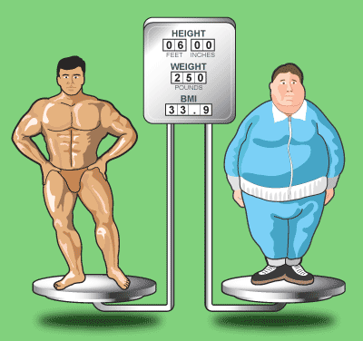
Comparison Operators
Comparison operators are used to compare variables
==, <, >, >=, <=, !=
Comparison operators example:
int a = 5;
int b = 4;
cout<<(a >= b)<<endl; // True
cout<<(a != b)<<endl; // True
cout<<(a == b)<<endl; // False
cout<<(a == a)<<endl; // True
cout<<(a != ++b)<<endl; // False
cout<<(a > b)<<endl; // False

Slide 22

Assignment Operators
Assignment operators are used to assign a value to a variable ,
=, +=, -=, |=, ...
Assignment operators example:
int x = 6;
int y = 4;
cout<<(y *= 2)<<endl; // 8
int z = y = 3; // y=3 and z=3
cout<<(z); // 3
cout<<(x |= 1)<<endl; // 7
cout<<(x += 3)<<endl; // 10
cout<<(x /= 2)<<endl; // 5

Slide 23

Comparison and Assignment Operators
Live Demo

Slide 24

Other Operators

Slide 25
Other Operators
Member access operator . is used to access object members
Square brackets [] are used with array's indexers
Parentheses ( ) are used to override the default operator precedence
Class cast operator (type) is used to cast one compatible type to another
Conditional operator ?: returns a value base on an bool expression
The new operator is used to create new objects

Slide 26

if and if-else
Implementing Conditional Logic

Slide 27
The if Statement
The most simple conditional statement
Enables you to test for a condition
Branch to different parts of the code depending on the result
The simplest form of an if statement:
if (condition)
{
statements;
}

Slide 28
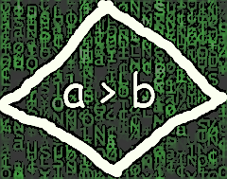
Condition and Statement
The condition can be:
Boolean variable
Boolean logical expression
Comparison expression
The condition can be of any type
Everything is TRUE, except for 0 and FALSE
The statement can be:
Single statement ending with a semicolon
Block enclosed in braces

Slide 29
How It Works?
condition
false
true
statement
The condition is evaluated
If it is true, the statement is executed
If it is false, the statement is skipped

Slide 30
The if Statement – Example
cout<<"Enter two numbers:"<<endl;
int biggerNumber;
int smallerNumber;
cin>>biggerNumber>>smallerNumber;
if (smallerNumber > biggerNumber)
{
biggerNumber = smallerNumber;
}
cout<<"The greater number is: "<<biggerNumber<<endl;

Slide 31

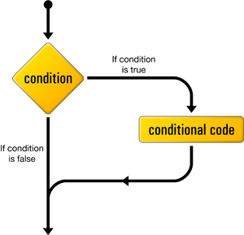
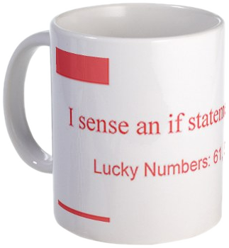
The if Statement
Live Demo

Slide 32
The if-else Statement
More complex and useful conditional statement
Executes one branch if the condition is true, and another if it is false
The simplest form of an if-else statement:
if (expression)
{
statement1;
}
else
{
statement2;
}

Slide 33
How It Works ?
condition
false
second
statement
true
first
statement
The condition is evaluated
If it is true, the first statement is executed
If it is false, the second statement is executed

Slide 34
if-else Statement – Example
Checking a number if it is odd or even
int number;
cin>>number;
if (number % 2 == 0)
{
cout<<"This number is even."<<endl;
}
else
{
cout<<"This number is odd."<<endl;
}

Slide 35
The if-else Statement
Live Demo

Slide 36
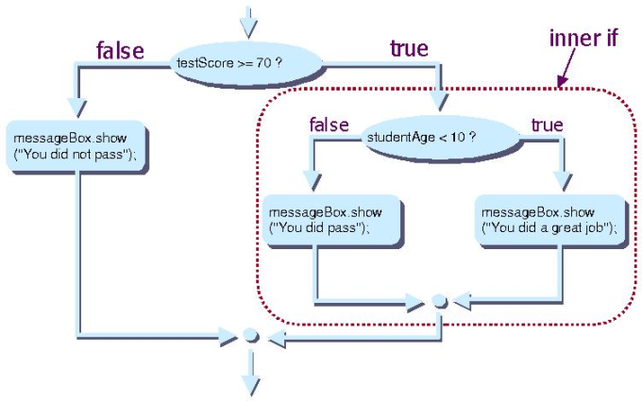
Nested if Statements
Creating More Complex Logic

Slide 37
Nested if Statements
if and if-else statements can be nested, i.e. used inside another if or else statement
Every else corresponds to its closest preceding if
if (expression)
{
if (expression)
{
statement;
}
else
{
statement;
}
}
else
statement;

Slide 38
Nested if – Good Practices
Always use { … } blocks to avoid ambiguity
Even when a single statement follows
Avoid using more than three levels of nested if statements
Put the case you normally expect to process first, then write the unusual cases
Arrange the code to make it more readable

Slide 39
Nested if Statements – Example
int first, second;
cin>>first>>second;
if (first == second)
{
cout<<"These two numbers are equal."<<endl;
}
else
{
if (first > second)
{
cout<<"The first number is bigger."<<endl;
}
else
{
cout<<"The second is bigger."<<endl;
}
}

Slide 40
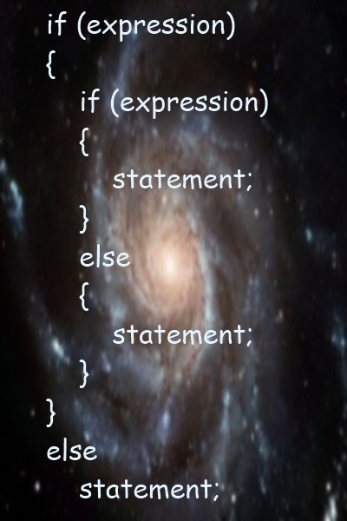
Nested if Statements
Live Demo

Slide 41
Multiple if-else-if-else-…
Sometimes we need to use another if-construction in the else block
Thus else if can be used:
int ch = 'X';
if (ch == 'A' || ch == 'a')
{
cout<<"Vowel [ei]";
}
else if (ch == 'E' || ch == 'e')
{
cout<<"Vowel [i:]";
}
else if …
else …

Slide 42
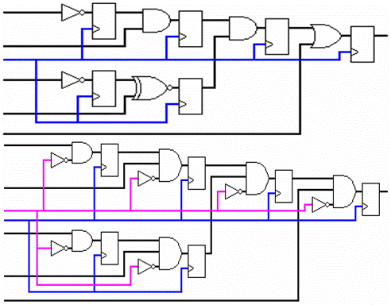
Multiple if-else Statements
Live Demo

Slide 43

switch-case
Making Several Comparisons at Once

Slide 44
The switch-case Statement
Selects for execution a statement from a list depending on the value of the switch expression
switch (day)
{
case 1: cout<<"Monday"; break;
case 2: cout<<"Tuesday"; break;
case 3: cout<<"Wednesday"; break;
case 4: cout<<"Thursday"; break;
case 5: cout<<"Friday"; break;
case 6: cout<<"Saturday"; break;
case 7: cout<<"Sunday"; break;
default: cout<<"Error!"; break;
}

Slide 45
How switch-case Works?
The expression is evaluated
When one of the constants specified in a case label is equal to the expression
The statement that corresponds to that case is executed
If no case is equal to the expression
If there is default case, it is executed
Otherwise the control is transferred to the end point of the switch statement

Slide 46

The switch-case Statement
Live Demo

Slide 47
Using switch – Good Practices
There must be a separate case for every normal situation
Put the normal case first
Put the most frequently executed cases first and the least frequently executed last
Order cases alphabetically or numerically
In default use case that cannot be reached under normal circumstances

Slide 48



Operators, Expressions and Conditionals
http://academy.telerik.com

Slide 49
Resources
Boolean algebra (logic)
http://en.wikipedia.org/wiki/Boolean_algebra_%28logic%29
Bitwise mask
http://en.wikipedia.org/wiki/Mask_%28computing%29
Bitwise operation
http://en.wikipedia.org/wiki/Bitwise_operation
Bit Twiddling Hacks
graphics.stanford.edu/~seander/bithacks.html

Slide 50
Operators Exercises

Slide 51
Exercises
Write an expression that checks if given integer is odd or even.
Write a boolean expression that checks for given integer if it can be divided (without remainder) by 7 and 5 in the same time.
Write an expression that calculates rectangle’s area by given width and height.
Write an expression that checks for given integer if its third digit (right-to-left) is 7. E. g. 1732 → true.
Write a boolean expression for finding if the bit 3 (counting from 0) of a given integer is 1 or 0.
Write an expression that checks if given point (x, y) is within a circle K(O, 5).

Slide 52
Exercises (2)
Write an expression that checks if given positive integer number n (n ≤ 100) is prime. E.g. 37 is prime.
Write an expression that calculates trapezoid's area by given sides a and b and height h.
Write an expression that checks for given point (x, y) if it is within the circle K( (1,1), 3) and out of the rectangle R(top=1, left=-1, width=6, height=2).
Write a boolean expression that returns if the bit at position p (counting from 0) in a given integer number v has value of 1. Example: v=5; p=1 → false.

Slide 53
Exercises (3)
Write an expression that extracts from a given integer i the value of a given bit number b. Example: i=5; b=2 → value=1.
We are given integer number n, value v (v=0 or 1) and a position p. Write a sequence of operators that modifies n to hold the value v at the position p from the binary representation of n.
Example: n = 5 (00000101), p=3, v=1 → 13 (00001101)
n = 5 (00000101), p=2, v=0 → 1 (00000001)

Slide 54
Exercises (4)
Write a program that exchanges bits 3, 4 and 5 with bits 24, 25 and 26 of given 32-bit unsigned integer.
* Write a program that exchanges bits {p, p+1, …, p+k-1) with bits {q, q+1, …, q+k-1} of given 32-bit unsigned integer.

Slide 55
Conditionals Exercises

Slide 56
Exercises
Write an if statement that examines two integer variables and exchanges their values if the first one is greater than the second one.
Write a program that shows the sign (+ or -) of the product of three real numbers without calculating it. Use a sequence of if statements.
Write a program that finds the biggest of three integers using nested if statements.
Sort 3 real values in descending order using nested if statements.

Slide 57
Exercises (2)
Write program that asks for a digit and depending on the input shows the name of that digit (in English) using a switch statement.
Write a program that enters the coefficients a, b and c of a quadratic equation
a*x² + b*x + c = 0
and calculates and prints its real roots. Note that quadratic equations may have 0, 1 or 2 real roots.
Write a program that finds the greatest of given 5 variables.

Slide 58
Exercises (3)
Write a program that, depending on the user's choice inputs int, double or string variable. If the variable is integer or double, increases it with 1. If the variable is string, appends "*" at its end. The program must show the value of that variable as a console output. Use switch statement.
We are given 5 integer numbers. Write a program that checks if the sum of some subset of them is 0. Example: 3, -2, 1, 1, 8 → 1+1-2=0.

Slide 59
Exercises (4)
Write a program that applies bonus scores to given scores in the range [1..9]. The program reads a digit as an input. If the digit is between 1 and 3, the program multiplies it by 10; if it is between 4 and 6, multiplies it by 100; if it is between 7 and 9, multiplies it by 1000. If it is zero or if the value is not a digit, the program must report an error.
Use a switch statement and at the end print the calculated new value in the console.

Slide 60
Exercises (5)
* Write a program that converts a number in the range [0...999] to a text corresponding to its English pronunciation. Examples:
0 → "Zero"
273 → "Two hundred seventy three"
400 → "Four hundred"
501 → "Five hundred and one"
711 → "Seven hundred and eleven"

